Slide 1
Wachovia District Communications Survey Findings

Slide 2
Why did we do a survey
Purpose
Designed to determine:
What forms of communications are our volunteers using?
What form of communication do they prefer to use?
How important are the different means of communication?

Slide 3
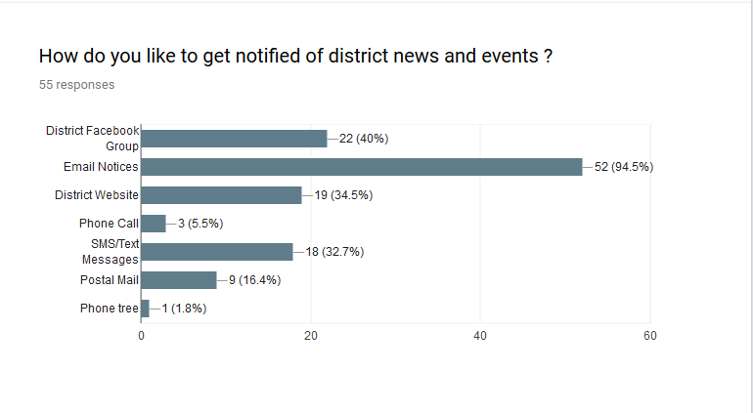
What did we find?
Types of communication

Slide 4
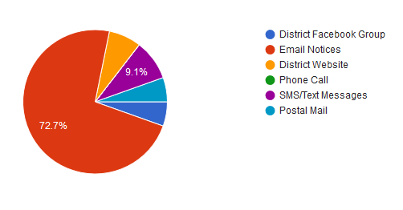
What did we find?
What do you use the most?

Slide 5
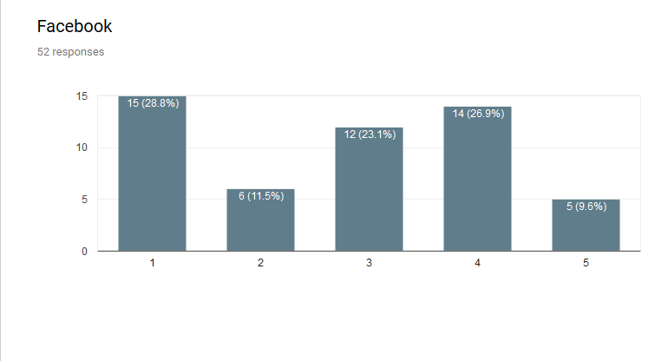
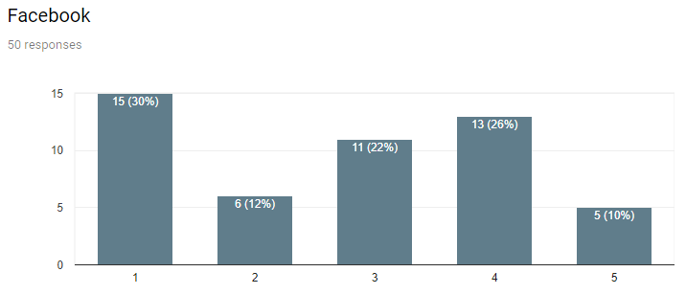
What did we find?
How important is…

Slide 6
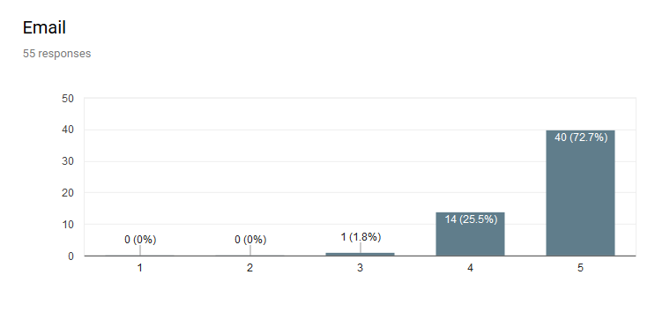
What did we find?
How important is…

Slide 7
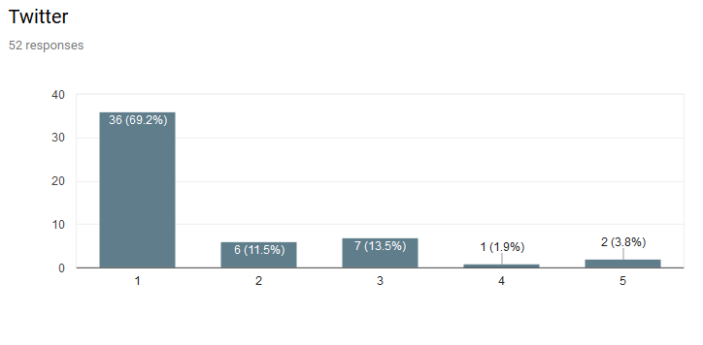
What did we find?
How important is…

Slide 8
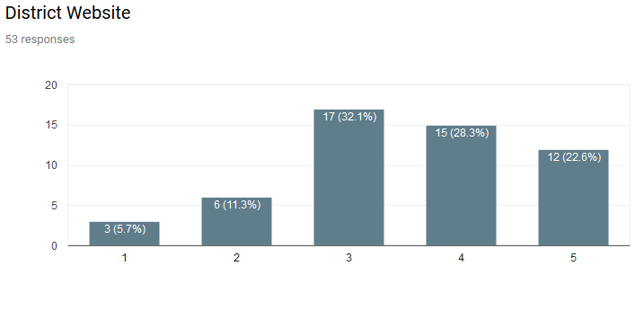
What did we find?
How important is…

Slide 9
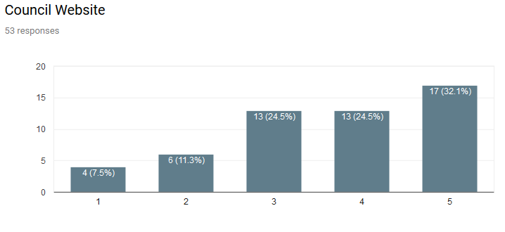
What did we find?
How important is…

Slide 10
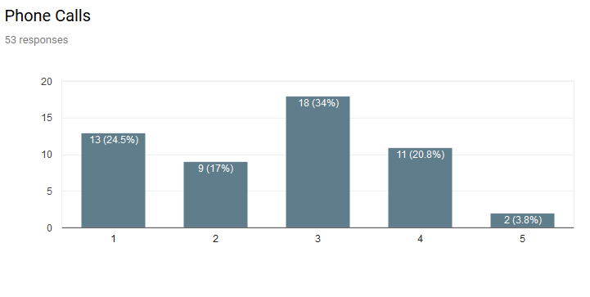
What did we find?
How important are…

Slide 11
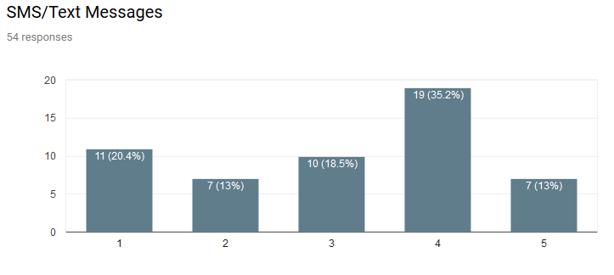
What did we find?
How important is…

Slide 12
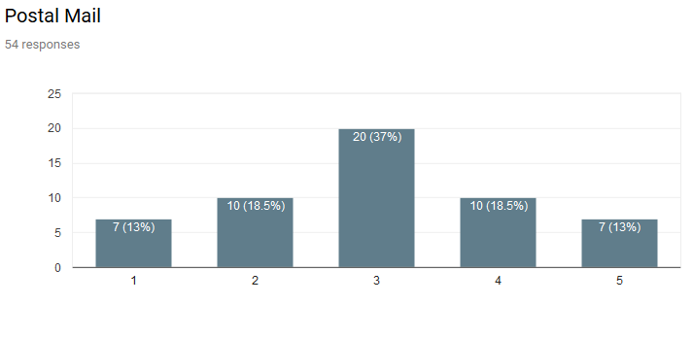
What did we find?
How important is…

Slide 13
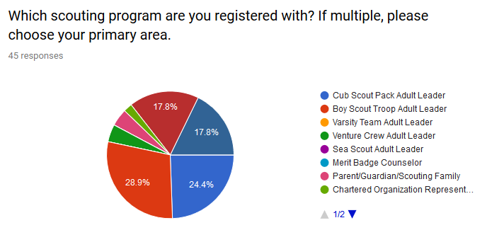
What did we find?
What roles in scouting responded?

Slide 14
The good and the bad
What are we doing right?
District meetings
Very responsive to all inquires and updates.
Using emails to keep in touch
this survey is a great step!!
How can we improve?
Use more electronic communication rather than relying on Round Tables to share information
Did not know there was a Facebook group of presence, Website seems clunky.
Update the council and district website with the information we need
make sure the website/google calendars are current for cub/troop/crew items

Slide 15
Important takeaways
Some of our assumptions were right…
…but not all of them.
We need to work on improving the quality of the information posted on our assets (Websites, Social Media, for example)
We should be aware of newer means of communicating with our district.

